Slide 1
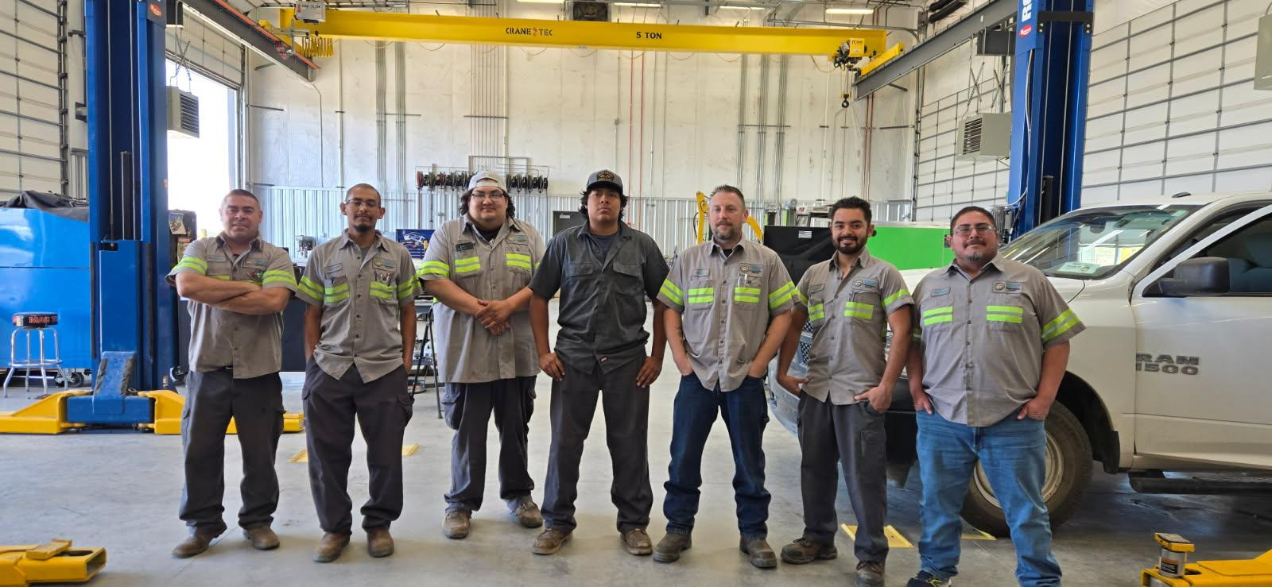

Isleta
Motor Pool
Howard
Bautisto

Slide 2
My
Accomplishments
Howard
Bautisto

Slide 3
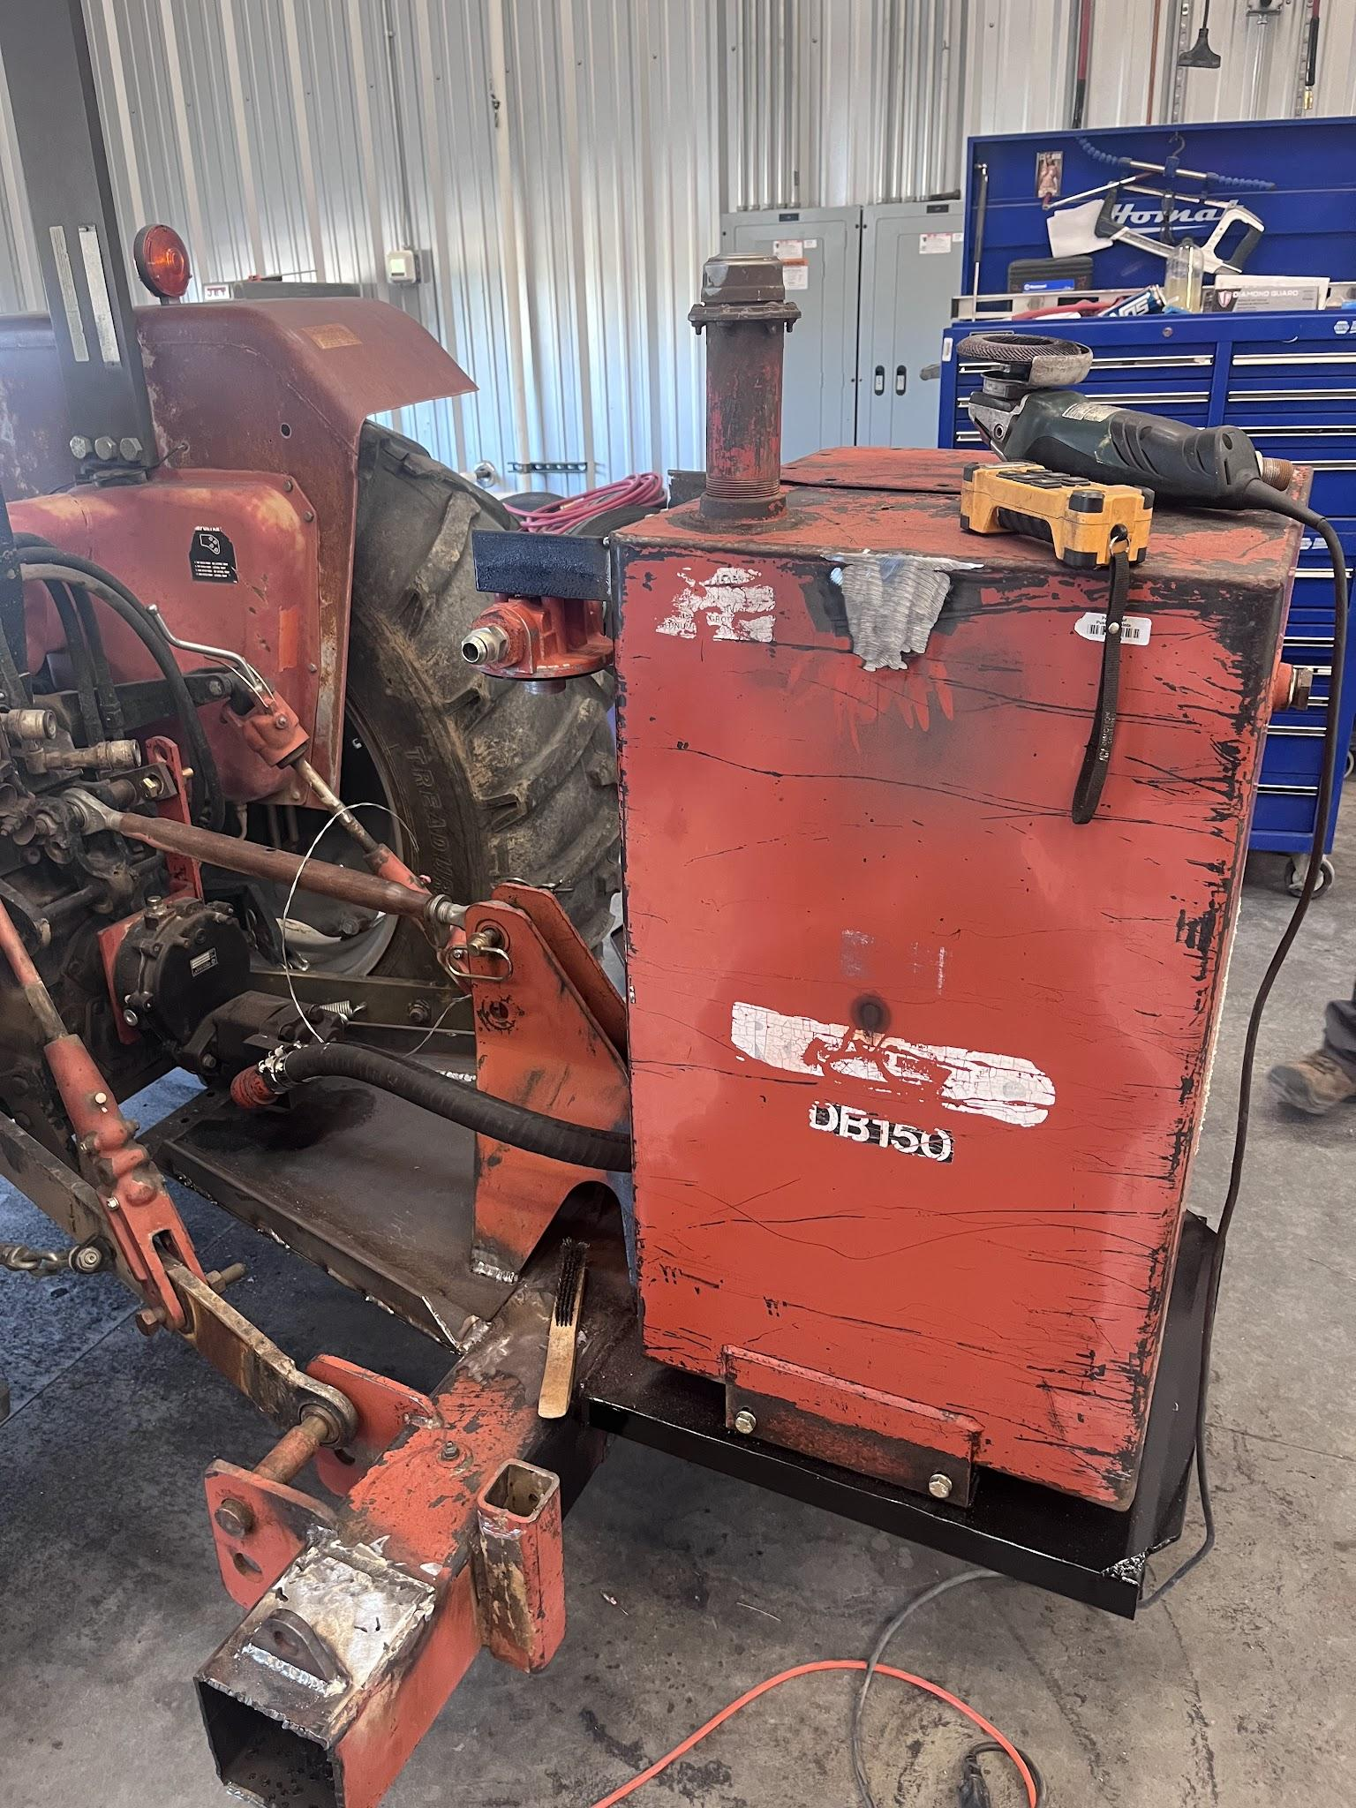


Slide 4
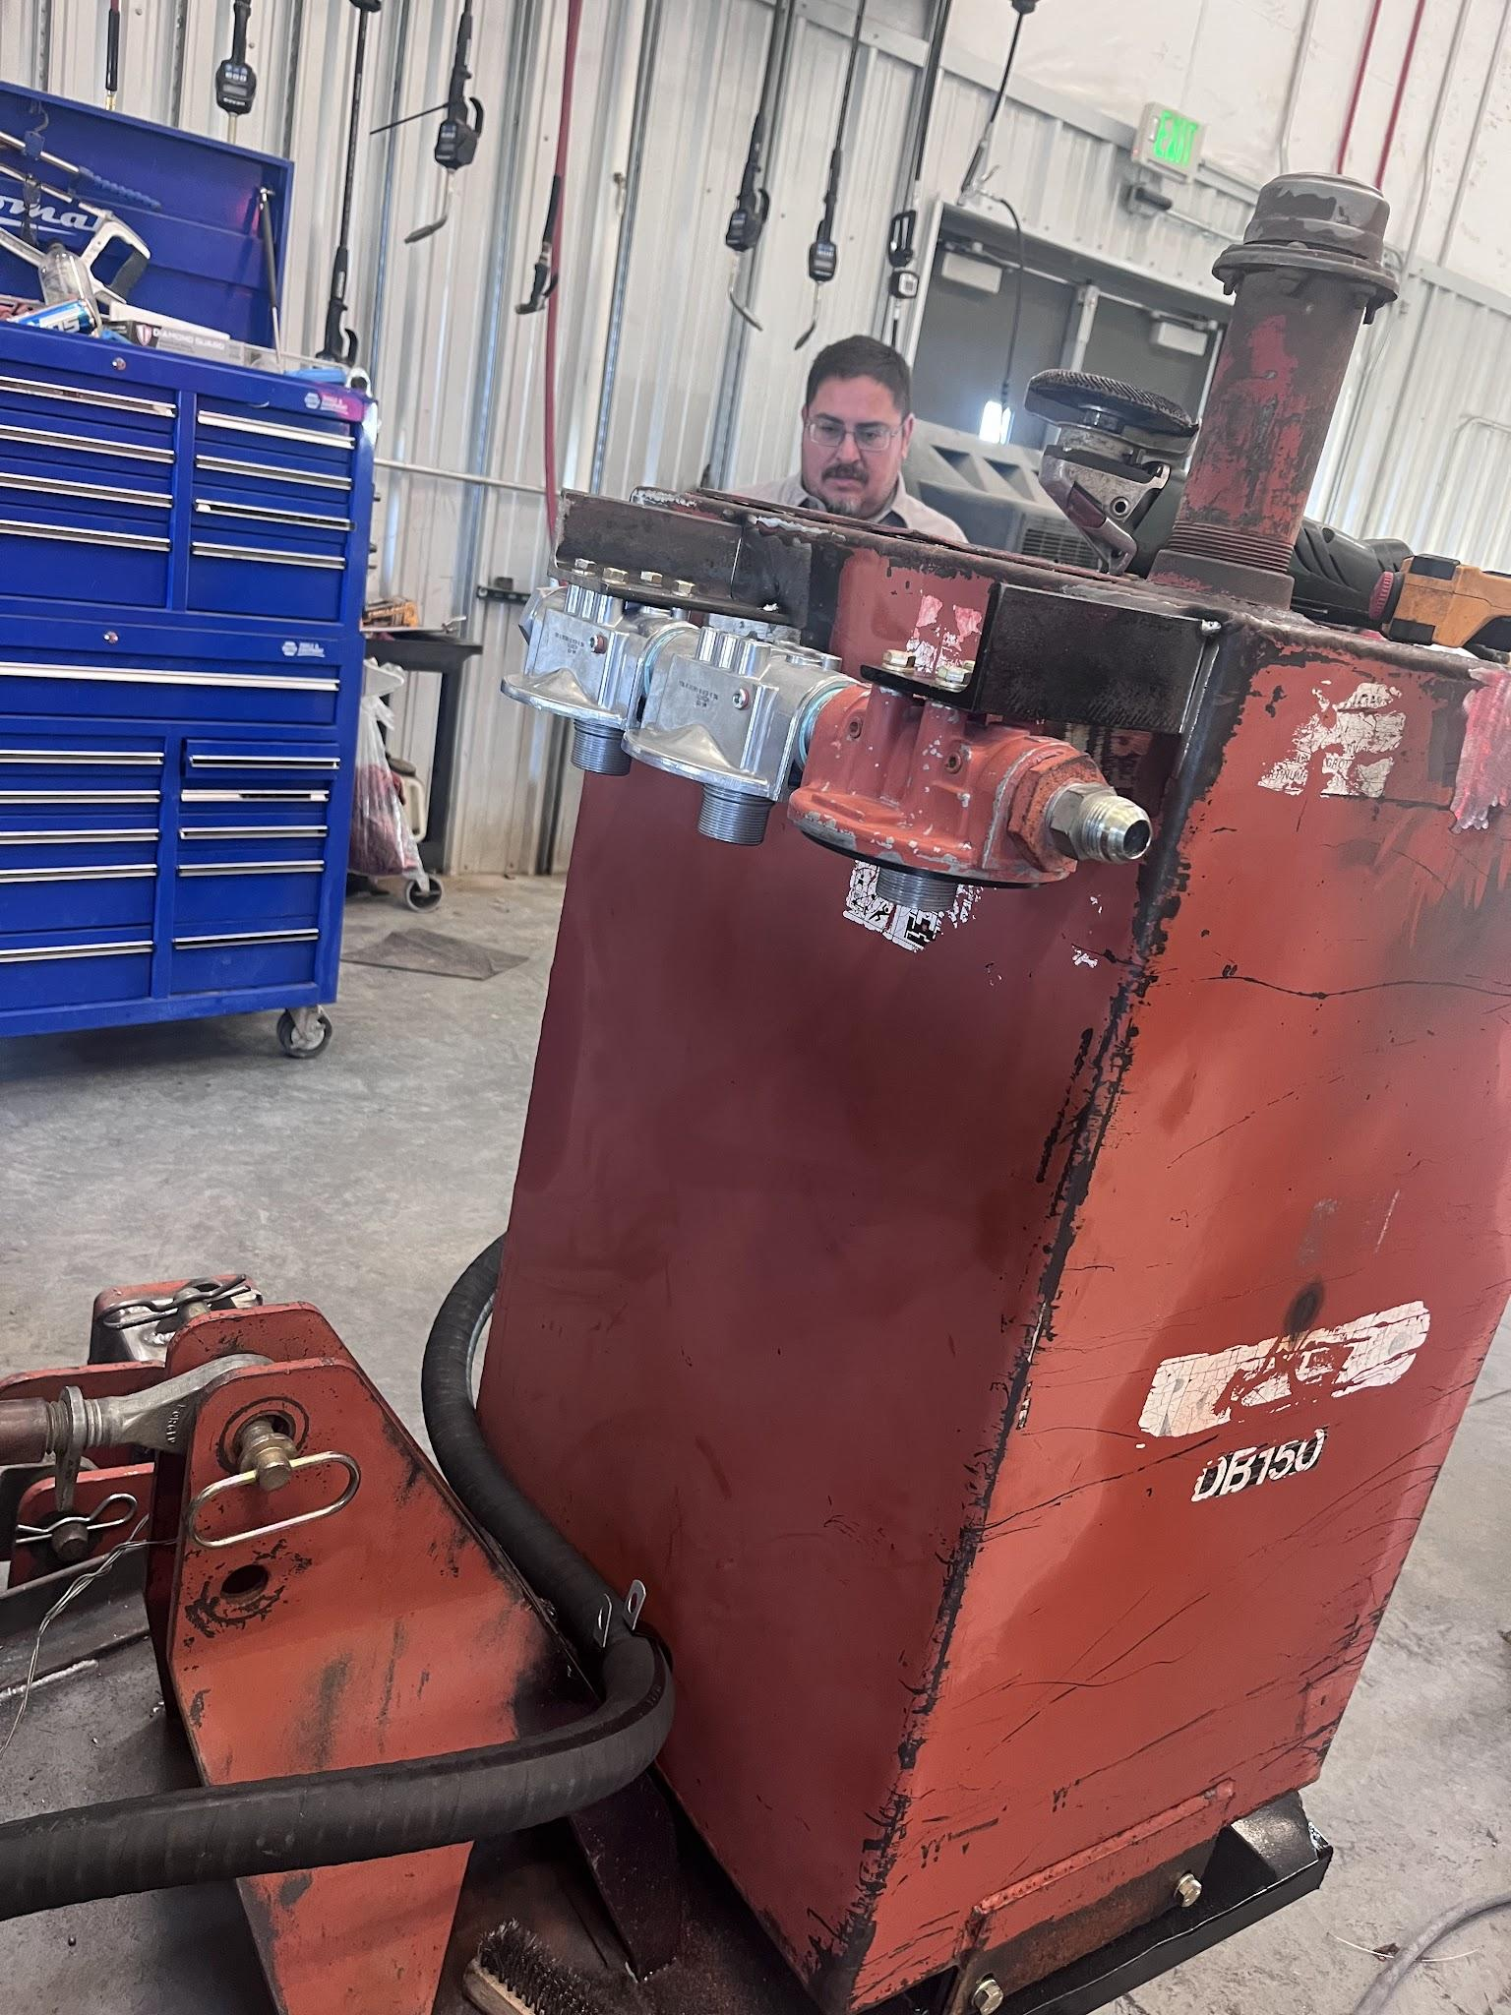

Slide 5
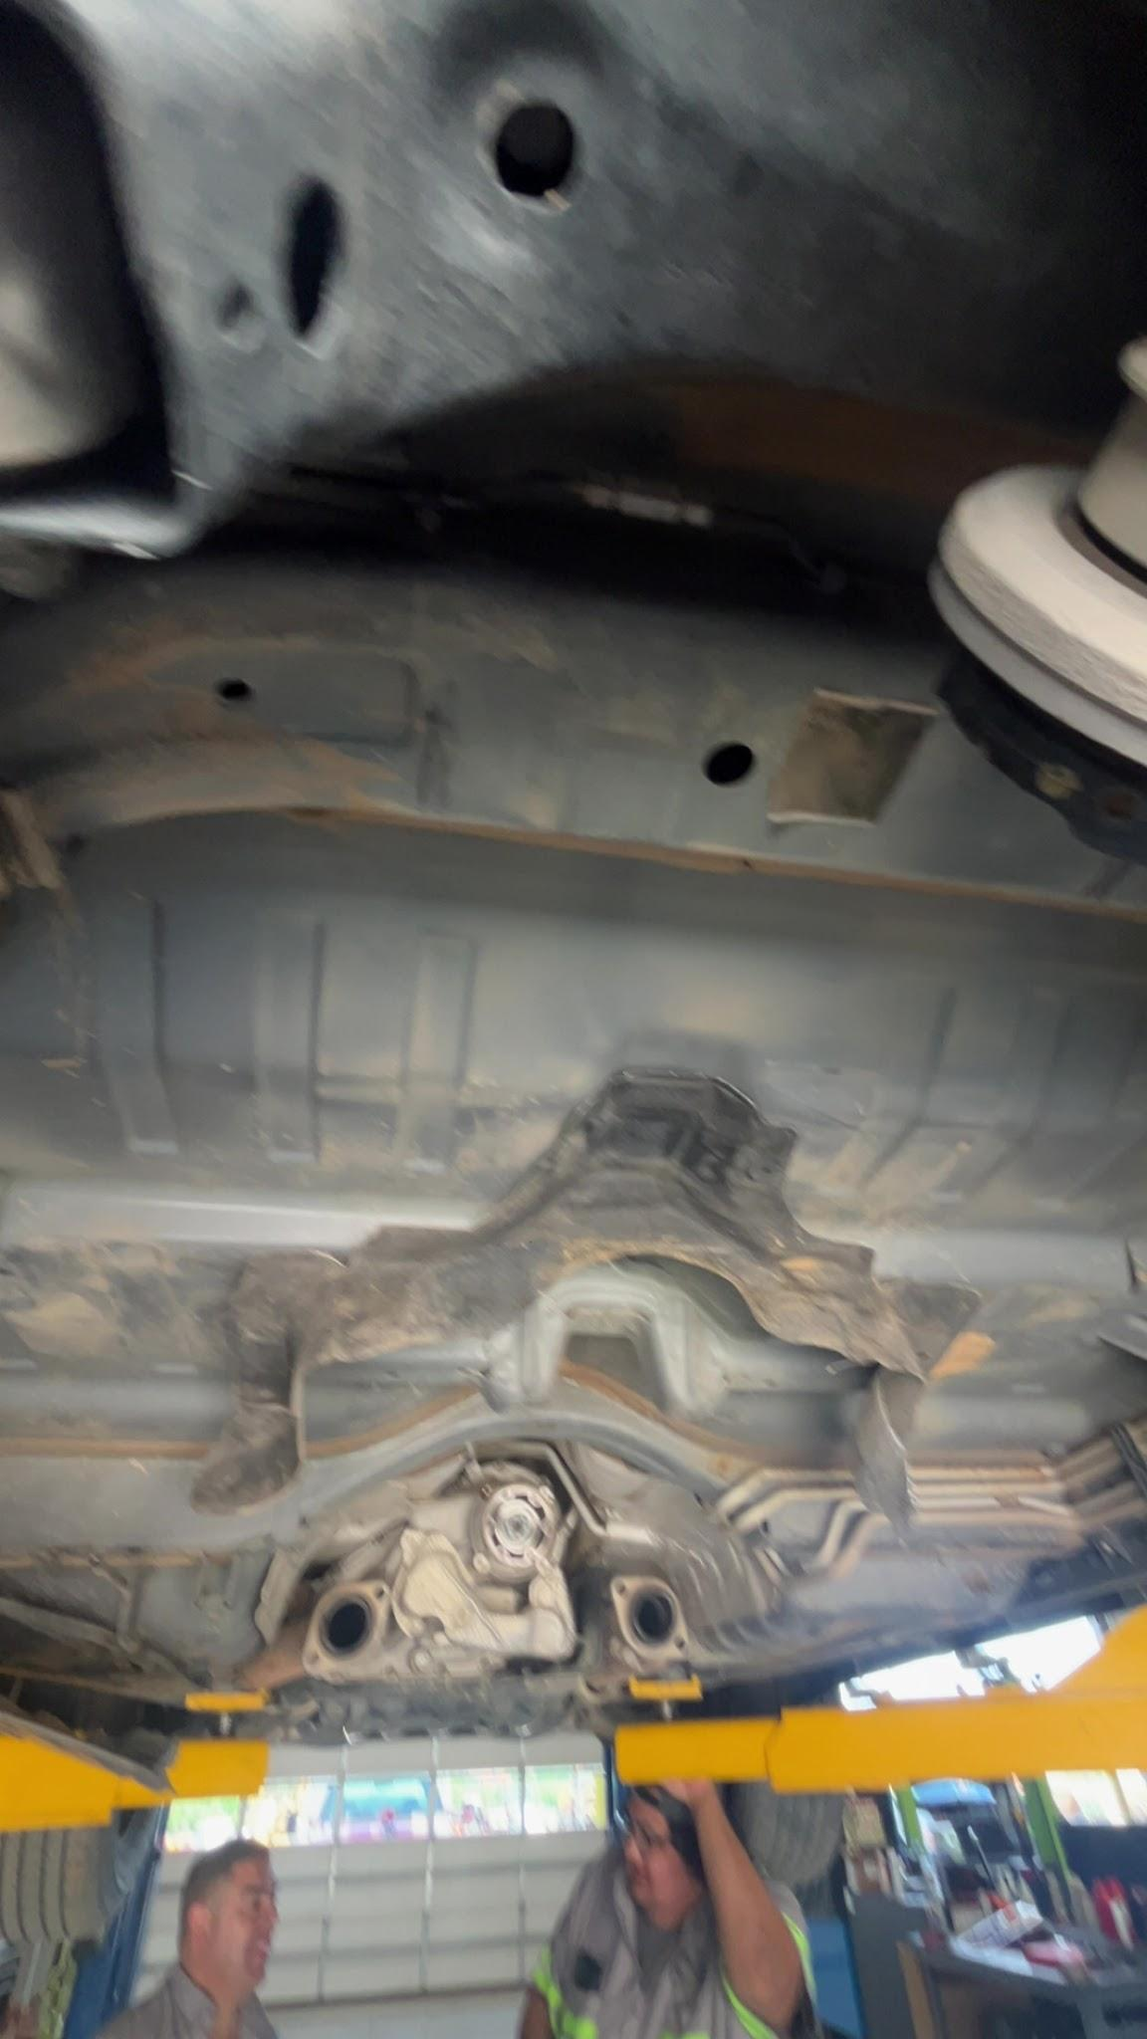

Slide 6
My experience
Howard
Bautisto

Slide 7
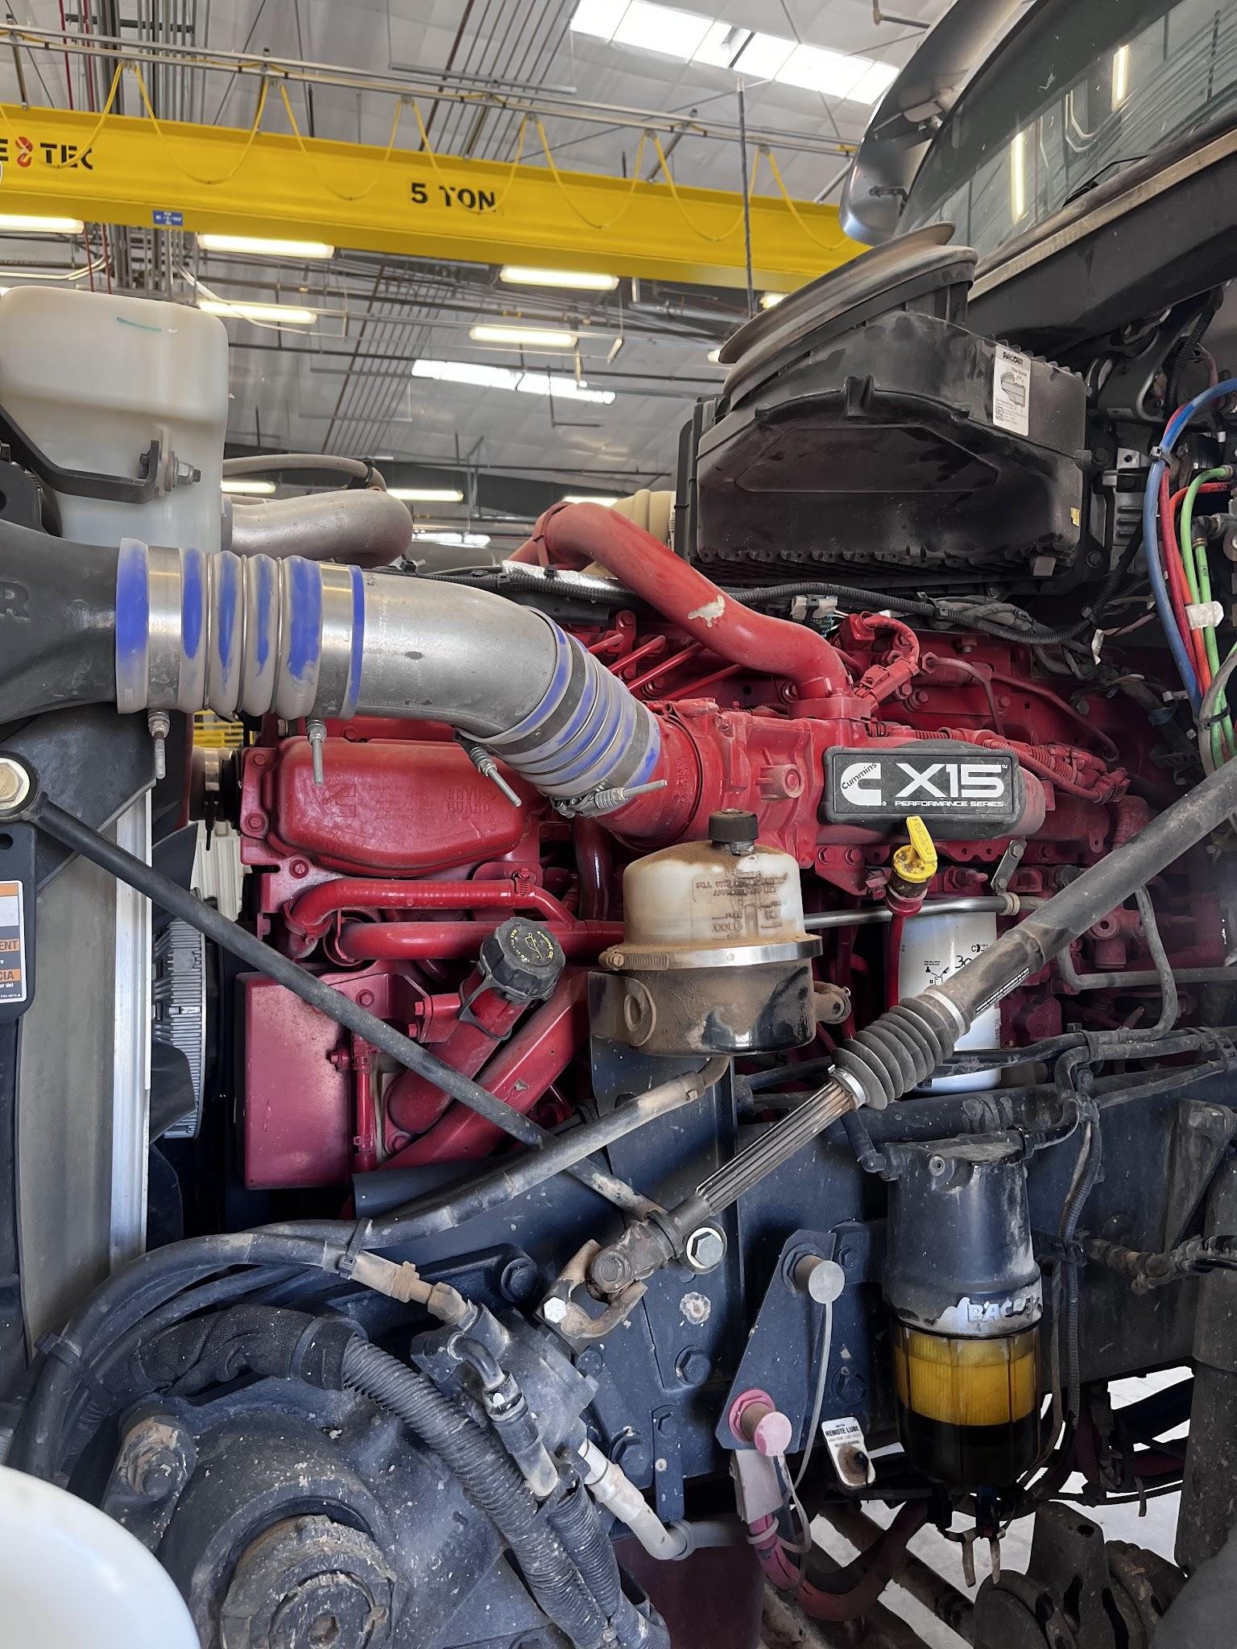

Slide 8
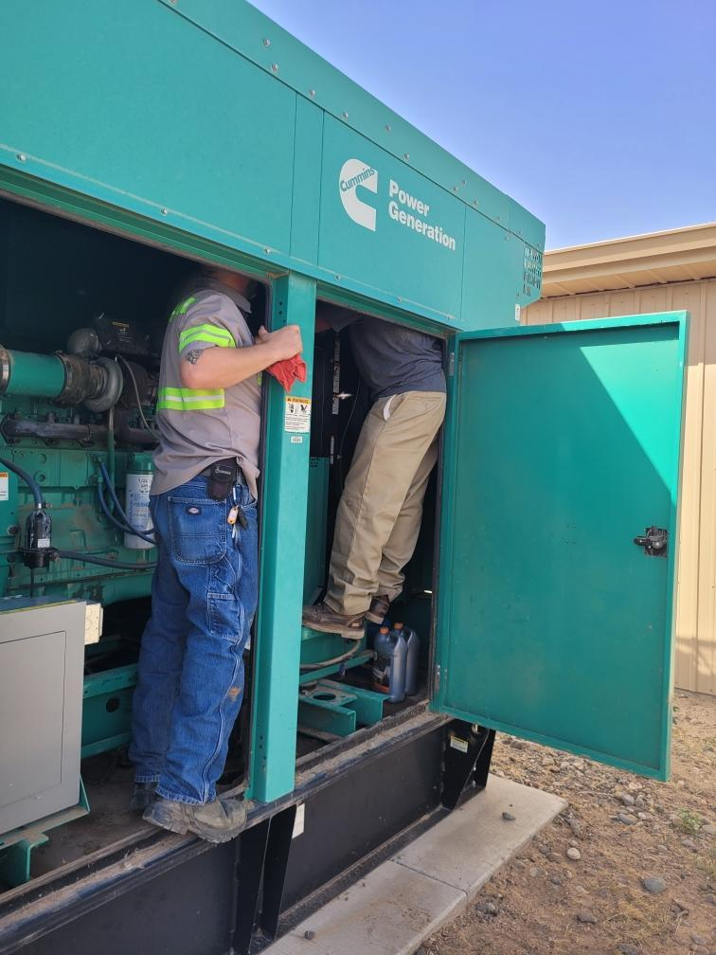

Slide 9
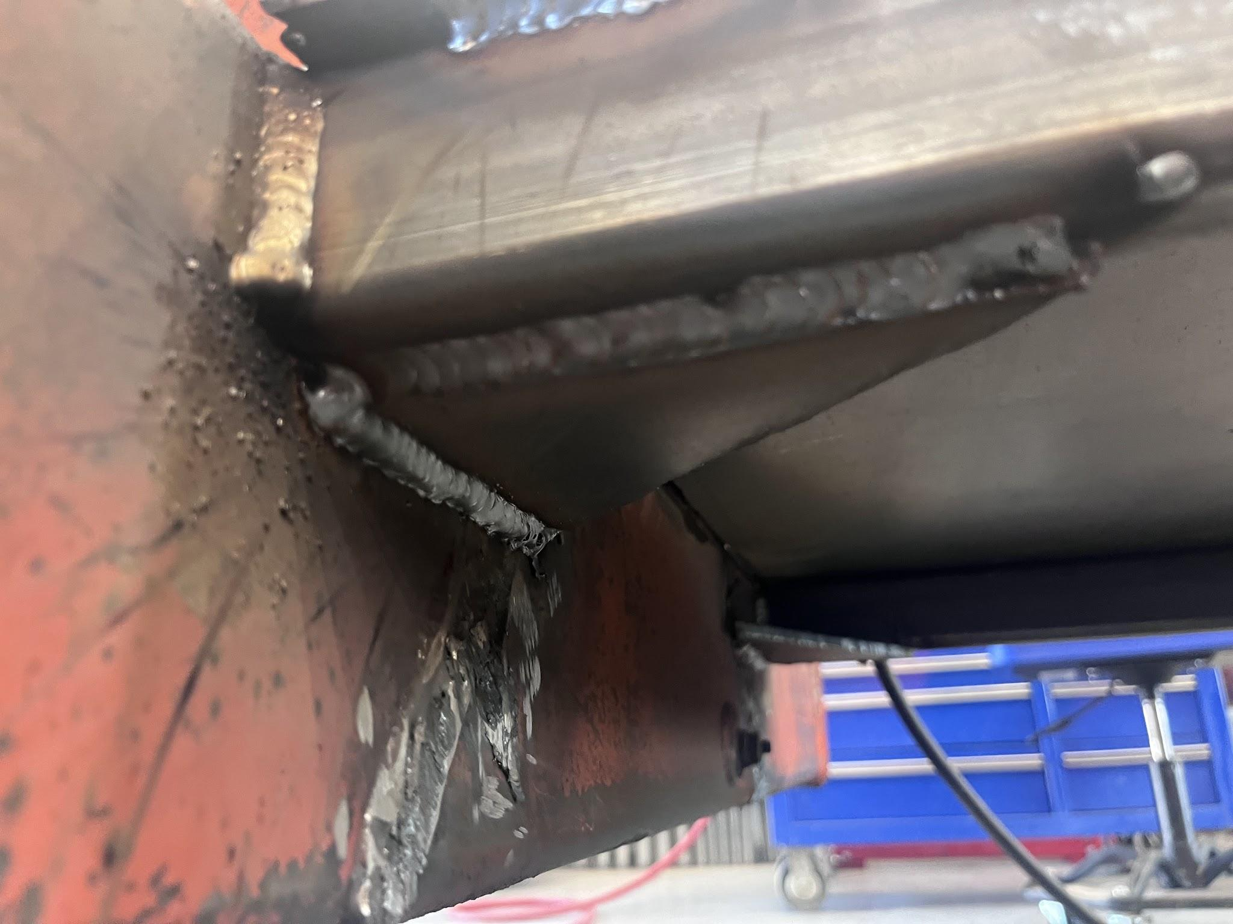

Slide 10
What I’ve learned
Howard
Bautisto

Slide 11
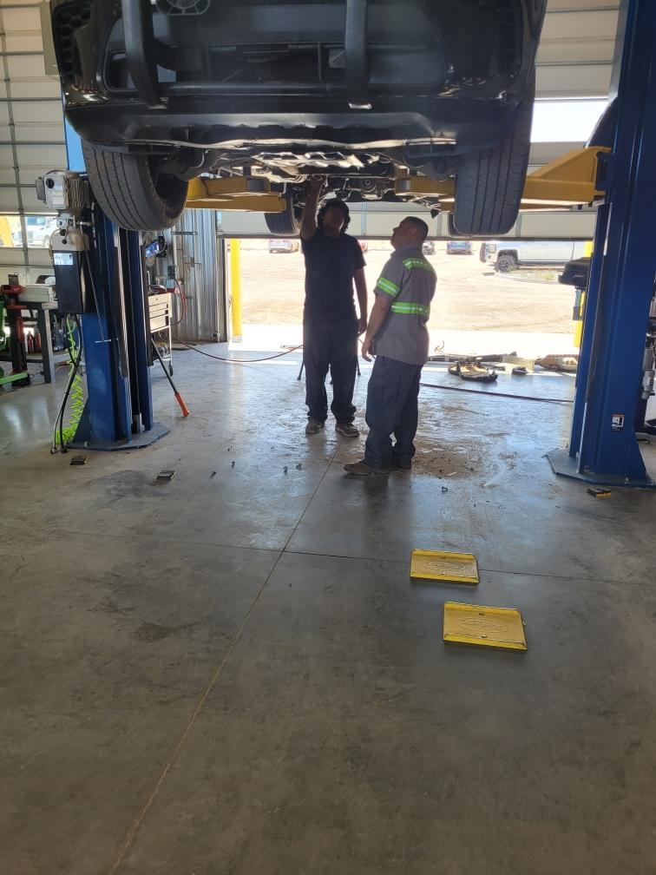

Slide 12
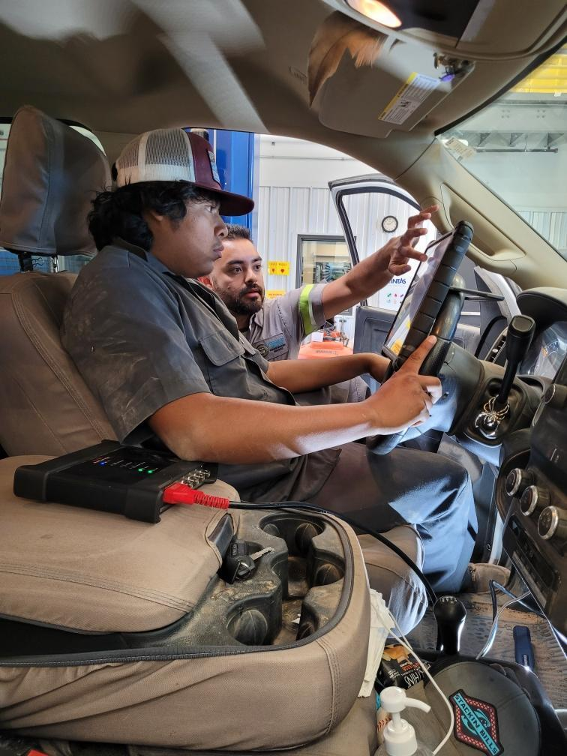

Slide 13
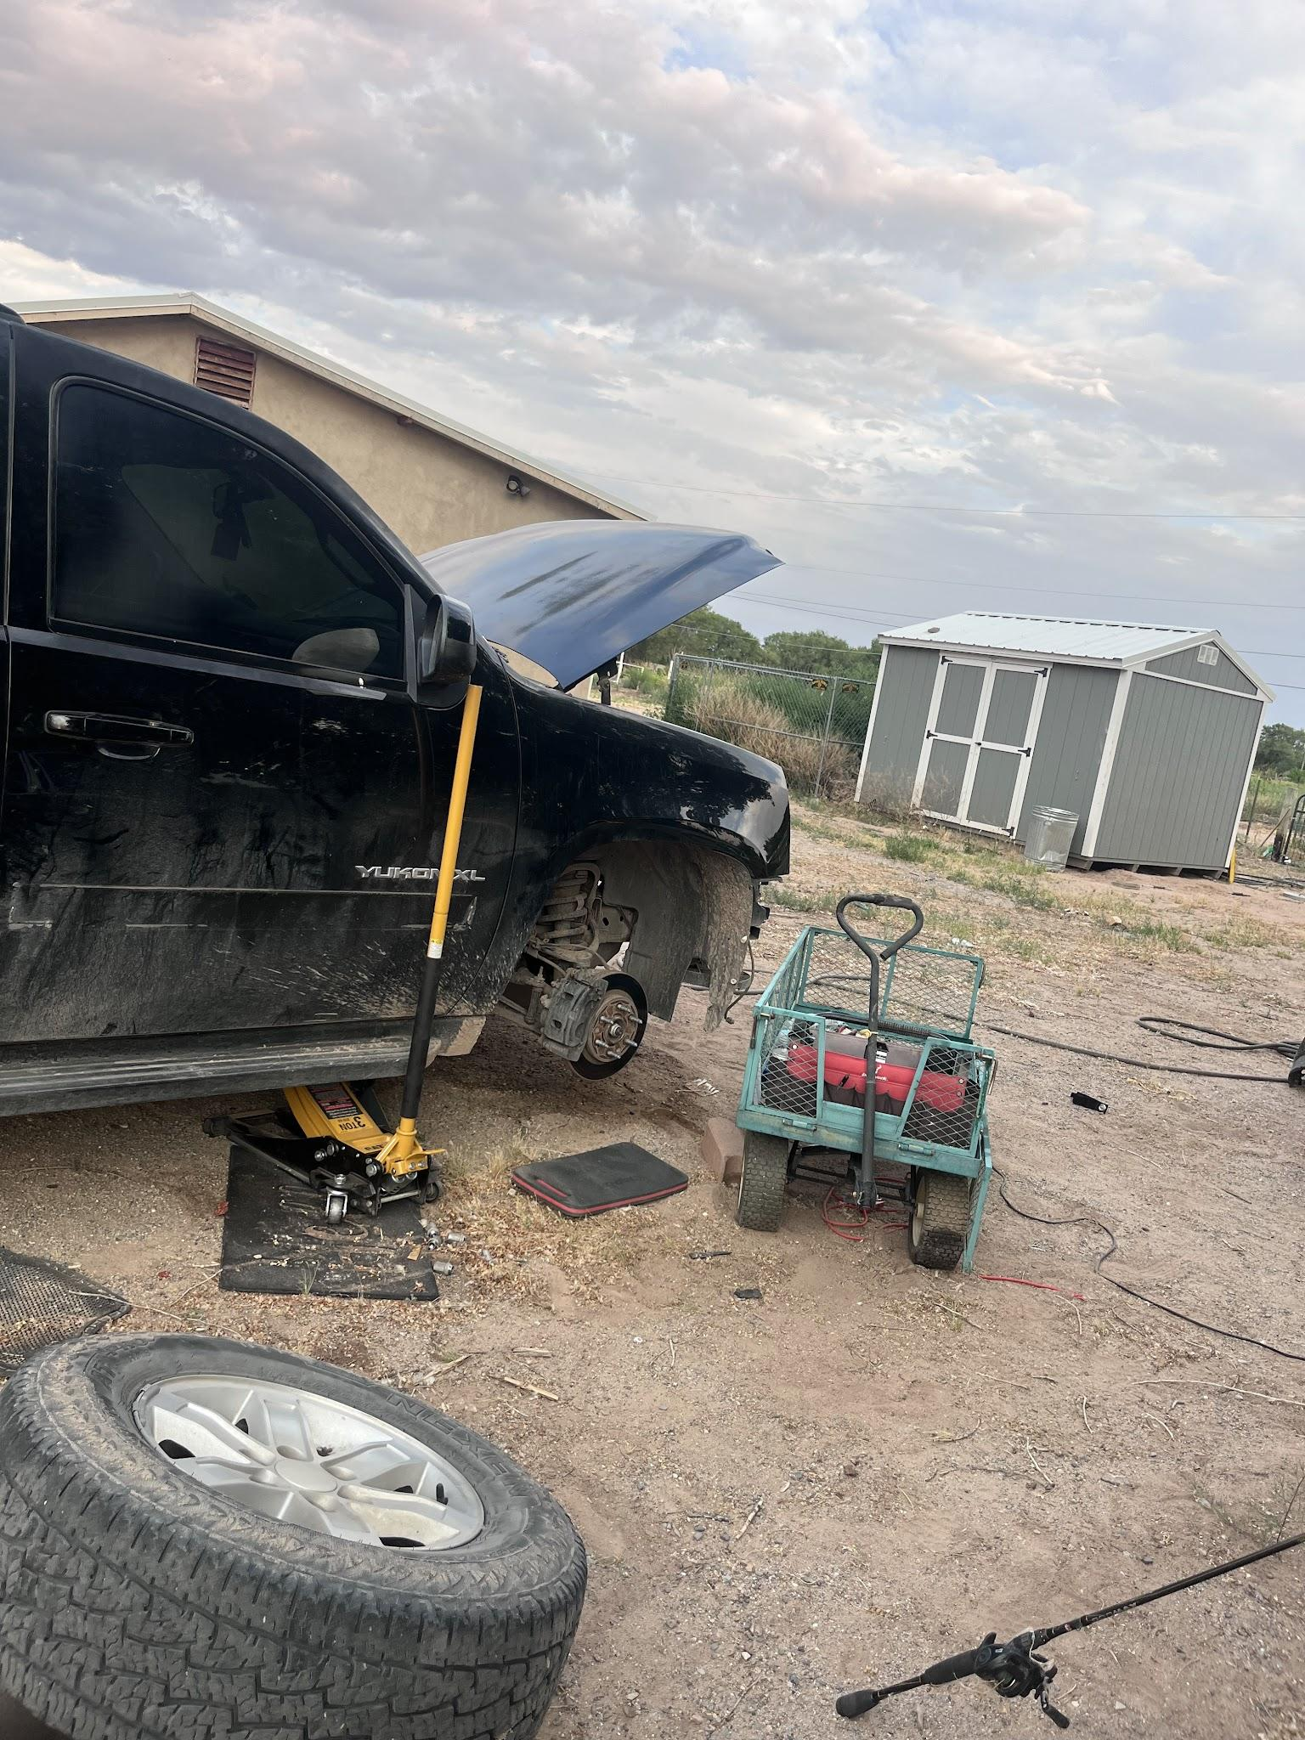

Slide 14
My plans to do with this experience
Howard
Howard

Slide 15
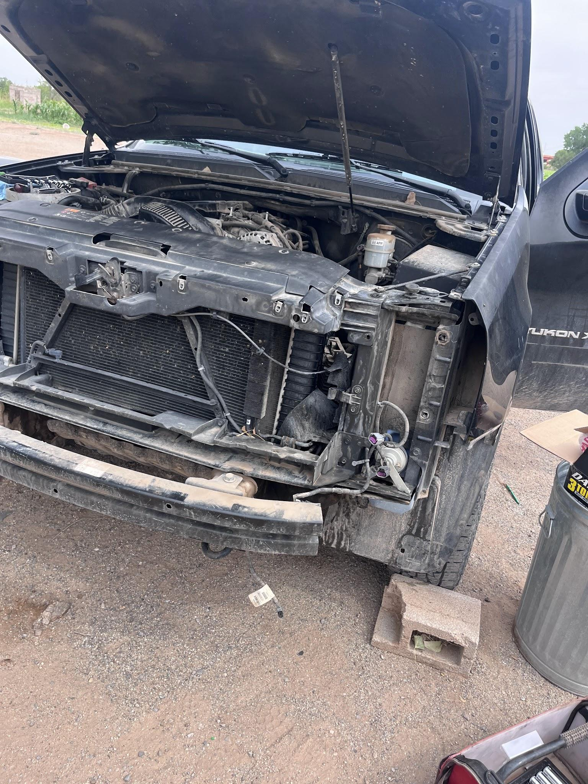

Slide 16
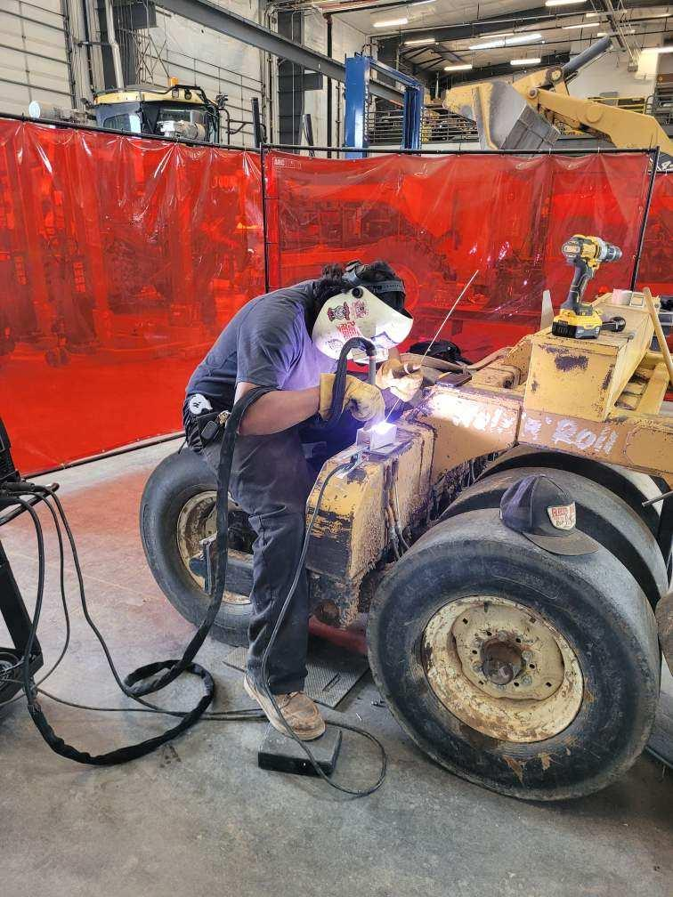

Slide 17
Thank
you

